Slide 1

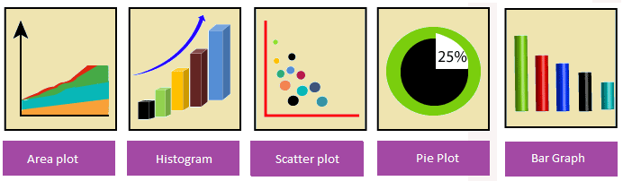
Data Handling using Pandas
Python Library – Matplotlib
Matplotlib is a comprehensive library for creating static, animated, and interactive visualizations in Python.It is used to create
Develop publication quality plots with just a few lines of code
Use interactive figures that can zoom, pan, update...
We can customize and Take full control of line styles, font properties, axes properties... as well as export and embed to a number of file formats and interactive environments

Slide 2


Data Handling using Pandas
Python Library – Pandas
It is a most famous Python package for data science, which offers powerful and flexible data structures that make data analysis and manipulation easy.Pandas makes data importing and data analyzing much easier. Pandas builds on packages like NumPy and matplotlib to give us a single & convenient place for data analysis and visualization work.

Slide 3
Data Handling using Pandas
Basic Features of Pandas
Dataframe object help a lot in keeping track of our data.
With a pandas dataframe, we can have different data types (float, int, string, datetime, etc) all in one place
Pandas has built in functionality for like easy grouping & easy joins of data, rolling windows
Good I/O capabilities; Easily pull data from a MySQL database directly into a data frame
With pandas, you can use patsy for R-style syntax in doing regressions.
Tools for loading data into in-memory data objects from different file formats.
Data alignment and integrated handling of missing data.
Reshaping and pivoting of data sets.
Label-based slicing, indexing and subsetting of large data sets.

Slide 4



Data Handling using Pandas
Pandas – Installation/Environment Setup Pandas module doesn't come bundled with Standard Python.
If we install Anaconda Python package Pandas will be installed by default.
Steps for Anaconda installation & Use
visit the site https://www.anaconda.com/download/
Download appropriate anaconda installer
After download install it.
During installation check for set path and all user
After installation start spyder utility of anaconda from start menu
Type import pandas as pd in left pane(temp.py)
Then run it.
If no error is show then it shows pandas is installed.
Like default temp.py we can create another .py file from new window option of file menu for new program.

Slide 5



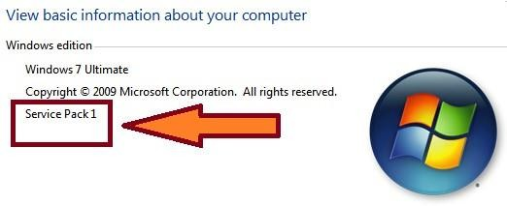
Data Handling using Pandas
Pandas – Installation/Environment Setup
Pandas installation can be done in Standard Python distribution,using following steps.
There must be service pack installed on our computer if we are using windows.If it is not installed then we will not be able to install pandas in existing Standard Python(which is already installed).So install it first(google it).
We can check it through properties option of my computer icon.
3. Now install latest version(any one above 3.8) of python.

Slide 6
Data Handling using Pandas
Pandas – Installation/Environment Setup
Now move to script folder of python distribution in command
prompt (through cmd command of windows).
Execute following commands in command prompt serially.
>pip install numpy
>pip install six
>pip install pandas
Wait after each command for installation
Now we will be able to use pandas in standard python distribution.
Type import pandas as pd in python (IDLE) shell.
If it executed without error(it means pandas is installed on your system)

Slide 7


Data Handling using Pandas
Data Structures in Pandas
Two important data structures of pandas are–Series, DataFrame
1. Series
Series is like a one-dimensional array like structure with homogeneous data. For example, the following series is a collection of integers.
Basic feature of series are
Homogeneous data
Size Immutable
Values of Data Mutable

Slide 8
Data Handling using Pandas
2. DataFrame DataFrame is like heterogeneous data.
a two-dimensional array with
SR. No. | Admn No | Student Name | Gender | Date Of Birth
1 | 001284 | NIDHI MANDAL | Female | 07/08/2010
2 | 001285 | SOUMYADIP BHATTACHARYA | Male | 24/02/2011
3 | 001286 | SHREYAANG SHANDILYA | Male | 29/12/2010
Basic feature of DataFrame are
Heterogeneous data
Size Mutable
Data Mutable

Slide 9
Data Handling using Pandas
Pandas Series
It is like one-dimensional array capable of holding data of any type (integer, string, float, python objects, etc.). Series can be created using constructor.
Syntax :- pandas.Series( data, index, dtype, copy) Creation of Series is also possible from – ndarray, dictionary, scalar value.
Series can be created using
Array
Dict
Scalar value or constant

Slide 10
Data Handling using Pandas
Pandas Series
Create an Empty Series
e.g.
import pandas as pseries s = pseries.Series() print(s)
Output
Series([], dtype: float64)

Slide 11
Data Handling using Pandas
Pandas Series : Create a Series from ndarray
Without index
e.g.
import pandas as pd1 import numpy as np1
data = np1.array(['a','b','c','d'])
s = pd1.Series(data) print(s)
Output
0 a
1 b
2 c
3 d
dtype: object
Note : default index is starting from 0
With index position
e.g.
import pandas as p1 import numpy as np1
data = np1.array(['a','b','c','d'])
s = p1.Series(data,index=[100,101,102,103])
print(s)
Output
100 a
101 b
102 c
103 d
dtype: object
Note : default index is starting from 100

Slide 12
Data Handling using Pandas
Pandas Series: Create a Series from dict
Eg.1(without index) import pandas as pd1 import numpy as np1
data = {'a' : 0., 'b' : 1., 'c' : 2.}
s = pd1.Series(data)
print(s)
Output a 0.0
b 1.0
c 2.0
dtype: float64
Eg.2 (with index) import pandas as pd1 import numpy as np1
data = {'a' : 0., 'b' : 1., 'c' : 2.}
s = pd1.Series(data,index=['b','c','d','a'])
print(s)
Output b 1.0
c 2.0
d NaN
a 0.0
dtype: float64

Slide 13
Data Handling using Pandas
Create a Series from Scalar e.g
import pandas as pd1 import numpy as np1
s = pd1.Series(5, index=[0, 1, 2, 3]) print(s)
Output 0 5
1 5
2 5
3 5
dtype: int64
Note :- here 5 is repeated for 4 times (as per no of index)

Slide 14
Data Handling using Pandas
Pandas Series: Maths operations with Series
e.g.
import pandas as pd1 s = pd1.Series([1,2,3])
t = pd1.Series([1,2,4])
u=s+t #addition operation
print (u)
u=s*t # multiplication operation
0 2
1 4
2 7
dtype: int64
print (u)
output
0 1
1 4
2 12
dtype: int64

Slide 15
Data Handling using Pandas
Pandas Series : head Function
e.g.
import pandas as pd1
s = pd1.Series([1,2,3,4,5],index = ['a','b','c','d','e']) print (s.head(3))
Output
a 1
2
3
dtype: int64
Return first 3 elements

Slide 16
Data Handling using Pandas
Pandas Series : tail Function
e.g.
import pandas as pd1
s = pd1.Series([1,2,3,4,5],index = ['a','b','c','d','e']) print (s.tail(3))
Output c 3
4
5
dtype: int64
Return last 3 elements

Slide 17



Data Handling using Pandas
Accessing Data from Series with indexing and slicing e.g.
import pandas as pd1
s = pd1.Series([1,2,3,4,5],index = ['a','b','c','d','e']) print (s[0])# for 0 index position
print (s[:3]) #for first 3 index values print (s[-2:]) # slicing for last 2 index values Output
1
1
2
3
dtype: int64 c
4
5
dtype: int64

Slide 18
Data Handling using Pandas
Pandas Series: Retrieve Data Using Label as (Index) e.g.
import pandas as pd1
s = pd1.Series([1,2,3,4,5],index = ['a','b','c','d','e']) print (s[['c','d']])
Output
c 3
d 4
dtype: int64

Slide 19
Data Handling using Pandas
Pandas Series: Retrieve Data from selection
There are three methods for data selection:
loc gets rows (or columns) with particular labels from the index.
iloc gets rows (or columns) at particular positions in the index (so it only takes integers).
ix usually tries to behave like loc but falls back to behaving like iloc if a label is not present in the index.
ix is deprecated and the use of loc and iloc is encouraged instead

Slide 20
Data Handling using Pandas
Pandas Series Retrieve Data from selection
e.g.
>>> s = pd.Series(np.nan, index=[49,48,47,46,45, 1, 2, 3, 4, 5])
>>> s.iloc[:3] # slice the first three rows
49 NaN
48 NaN
47 NaN
>>> s.ix[:3] # the integer is in the index so s.ix[:3] works like loc
49 NaN
48 NaN
47 NaN
46 NaN
45 NaN
NaN
NaN
NaN
>>> s.loc[:3] # slice up to and including label 3
49 NaN
48 NaN
47 NaN
46 NaN
45 NaN
NaN
NaN
NaN

Slide 21
Data Handling using Pandas
Pandas DataFrame
It is a two-dimensional data structure, just like any table (with rows & columns).
Basic Features of DataFrame
Columns may be of different types
Size can be changed(Mutable)
Labeled axes (rows / columns)
Arithmetic operations on rows and columns
Structure
SR. No. | Admn No | Student Name | Gender | Date Of Birth
1 | 001284 | NIDHI MANDAL | Female | 07/08/2010
2 | 001285 | SOUMYADIP BHATTACHARYA | Male | 24/02/2011
3 | 001286 | SHREYAANG SHANDILYA | Male | 29/12/2010
Rows
It can be created using constructor
pandas.DataFrame( data, index, columns, dtype, copy)

Slide 22
Pandas DataFrame Create DataFrame
It can be created with followings
Lists
dict
Series
Numpy ndarrays
Another DataFrame
Create an Empty DataFrame
e.g.
import pandas as pd1 df1 = pd1.DataFrame() print(df1)
Empty DataFrame Columns: [ ] Index: [ ]
output

Slide 23
Pandas DataFrame : Create a DataFrame from Lists e.g.1
import pandas as pd1 data1 = [1,2,3,4,5]
df1 = pd1.DataFrame(data1) print (df1)
e.g.2
import pandas as pd1
0
0 | 1
1 | 2
2 | 3
3 | 4
4 | 5
output
data1 = [['Freya',20],['Mohak',22],['Dwivedi',23]]
df1 = pd1.DataFrame(data1,index=[1,2,3], columns=['Name','Age'])
print(df1)
Name Age
output
Freya 20
Mohak 22
Dwivedi 23
Write below for numeric value as float
df1 = pd1.DataFrame(data,columns=['Name','Age'],dtype=float)

Slide 24
Pandas DataFrame
Create a DataFrame from Dict of ndarrays / Lists e.g.1
import pandas as pd1
data1 = {'Name':['Freya', 'Mohak',‘Sona'],'Age':[9,10,26]} df1 = pd1.DataFrame(data1, index=[1,2,3])
print (df1)
Output
Name Age
Freya 9
Mohak 10
Sona 26
Write below as 3rd statement in above prog for indexing
df1 = pd1.DataFrame(data1, index=['rank1','rank2','rank3'])
Instead of 1,2,3 now rank1, rank2, rank3 will be displayed

Slide 25
Pandas DataFrame
Create a DataFrame from List of Dicts
e.g.1
import pandas as pd1
data1 = [{'x': 1, 'y': 2},{'x': 5, 'y': 4, 'z': 5}]
df1 = pd1.DataFrame(data1) print (df1)
Output
x y z
0 1 | 2 | NaN
1 5 | 4 | 5.0
Write below as 3rd statement in above program for indexing
df1 = pd1.DataFrame(data1, index=['first', 'second'])
x y z
first 1 | 2 | NaN
Second 5 | 4 | 5.0

Slide 26
Pandas DataFrame
Create a DataFrame from Dict of Series
e.g.1
import pandas as pd1
d1 = {'one' : pd1.Series([1, 2, 3], index=['a', 'b', 'c']),
'two' : pd1.Series([1, 2, 3, 4], index=['a', 'b', 'c', 'd'])}
df1 = pd1.DataFrame(d1)
print (df1)
Output
one two
a 1.0 1
b 2.0 2
c 3.0 3
d NaN 4
Column Selection -> print (df ['one'])
Adding a new column by passing as Series: -> df1['three']=pd1.Series([10,20,30],index=['a','b','c'])
Adding a new column using the existing columns values df1['four']=df1['one']+df1['three']

Slide 27
Data Handling using Pandas
Create a DataFrame from .txt file
Having a text file './inputs/dist.txt' as:
1 | 1 | 12.92
1 | 2 | 90.75
1 | 3 | 60.90
2 | 1 | 71.34
Pandas is shipped with built-in reader methods. For example the pandas.read_table method seems to be a good way to read (also in chunks) a tabular data file.
import pandas
df = pandas.read_table('./input/dists.txt', delim_whitespace=True,
names=('A', 'B', 'C'))
will create a DataFrame objects with column named A made of data of type int64, B of int64 and C of float64

Slide 28
Data Handling using Pandas
Create a DataFrame from csv(comma separated value) file / import data from csv file
e.g.
Suppose filename.csv file contains following data Date,"price","factor_1","factor_2"
2012-06-11,1600.20,1.255,1.548
2012-06-12,1610.02,1.258,1.554
import pandas as pd
# Read data from file 'filename.csv'
# (in the same directory that your python program is based)
# Control delimiters, rows, column names with read_csv
data = pd.read_csv("filename.csv")
# Preview the first 1 line of the loaded data data.head(1)

Slide 29
Data Handling using Pandas
Pandas DataFrame Column addition
df = pd.DataFrame({"A": [1, 2, 3], "B": [4, 5, 6]})
c = [7,8,9]
df[‘C'] = c
Column Deletion
del df1['A'] # Deleting the first column using DEL function
df.pop('B') #Deleting another column using POP function
Rename columns
df = pd.DataFrame({"A": [1, 2, 3], "B": [4, 5, 6]}) df=df.rename(columns={"A": "a", "B": "c"})
a c
0 1 4
1 2 5
2 3 6

Slide 30
Data Handling using Pandas
Pandas DataFrame
Row Selection, Addition, and Deletion
#Selection by Label
import pandas as pd1
d1 = {'one' : pd1.Series([1, 2, 3], index=['a', 'b', 'c']),
'two' : pd1.Series([1, 2, 3, 4], index=['a', 'b', 'c', 'd'])}
df1 = pd1.DataFrame(d1)
print (df1.loc['b'])
df1.loc[‘b’] will show the values of one and two corresponding to index ‘b’
Output
one 2.0
two 2.0
Name: b, dtype: float64

Slide 31
Data Handling using Pandas
Pandas DataFrame
#Selection by integer location
import pandas as pd1
d1 = {'one' : pd1.Series([1, 2, 3], index=['a', 'b', 'c']),
'two' : pd1.Series([1, 2, 3, 4], index=['a', 'b', 'c', 'd'])}
df1 = pd1.DataFrame(d1)
print (df1.iloc[2])
Output
one 3.0
two 3.0
Name: c, dtype: float64
Slice Rows : Multiple rows can be selected using ‘ : ’ operator.
print (df1[2:4])

Slide 32
Data Handling using Pandas
Pandas DataFrame
Addition of Rows
import pandas as pd1
df1 = pd1.DataFrame([[1, 2], [3, 4]], columns = ['a','b'])
df2 = pd1.DataFrame([[5, 6], [7, 8]], columns = ['a','b'])
df1 = df1.append(df2)
print (df1)
Output:
a b
0 1 2
1 3 4
0 5 6
1 7 8
Deletion of Rows
# Drop rows with label 0
df1 = df1.drop(0)

Slide 33
Pandas DataFrame
Iterate over rows in a dataframe
e.g.
import pandas as pd1
import numpy as np1
data1 = {'name': ['freya', 'mohak'],
'age': [10, 1],
'favorite_color': ['pink', 'blue'], 'grade': [88, 92]}
df1 = pd1.DataFrame(data1, columns = ['name', 'age', 'favorite_color', 'grade'])
for index, row in df1.iterrows():
print (index, row["name"], row["age"])
Since the row data is returned as a Series, we can use the column names to access each column’s value in the row. Here we loop through each row and we assign the row index and row data to variables named index and row. Then we access row data using the column names of the dataframe.
Output
0 freya 10
1 mohak 1

Slide 34
Pandas DataFrame
Head & Tail
head() returns the first n rows (observe the index values). The default number of elements to display is five, but you may pass a custom number. tail() returns the last n rows .e.g.
import pandas as pd import numpy as np
#Create a Dictionary of series
d = {'Name':pd.Series(['Tom','James','Ricky','Vin','Steve','Smith','Jack']), 'Age':pd.Series([25,26,25,23,30,29,23]), 'Rating':pd.Series([4.23,3.24,3.98,2.56,3.20,4.6,3.8])}
#Create a DataFrame df = pd.DataFrame(d)
print ("Our data frame is:") print (df)
print ("The first two rows of the data frame is:") print( df.head(2))

Slide 35
Pandas DataFrame
Indexing a DataFrame using .loc[ ] :
This function selects data by the label of the rows and columns. #import the pandas library and aliasing as pd
import pandas as pd import numpy as np
df = pd.DataFrame(np.random.randn(8, 4),
index = ['a','b','c','d','e','f','g','h'], columns = ['A', 'B', 'C', 'D'])
#select all rows for a specific column print (df.loc[:,'A'])
#select row for a specific column
print (df.loc['b','A'])

Slide 36
Pandas DataFrame
Accessing a DataFrame with a boolean index :
In order to access a dataframe with a boolean index, we have to create a dataframe in which index of dataframe contains a boolean value that is “True” or “False”.
# importing pandas as pd import pandas as pd
# dictionary of lists
dict = {'name':[“Mohak", “Freya", “Roshni"],
'degree': ["MBA", "BCA", "M.Tech"],
'score':[90, 40, 80]}
# creating a dataframe with boolean index
df = pd.DataFrame(dict, index = [True, False, True]) # accessing a dataframe using .loc[] function
print(df.loc[True]) #it will return rows of Mohak and Roshni only(matching true only)

Slide 37
Binary operation over dataframe with series e.g.
import pandas as pd
x = pd.DataFrame({0: [1,2,3], 1: [4,5,6], 2: [7,8,9] })
y = pd.Series([1, 2, 3]) new_x = x.add(y, axis=0) print(new_x)
Output
axis=0 will add column wise
axis=1 will add row wise
0 | 1 | 2
0 2 | 5 | 8
1 4 | 7 | 10
2 6 | 9 | 12

Slide 38
Data Handling using Pandas
Binary operation over dataframe with dataframe
import pandas as pd
x = pd.DataFrame({0: [1,2,3], 1: [4,5,6], 2: [7,8,9] })
y = pd.DataFrame({0: [1,2,3], 1: [4,5,6], 2: [7,8,9] })
new_x = x.add(y, axis=0)
print(new_x) Output
0 1 2
0 2 8 14
1 4 10 16
2 6 12 18
Note :- similarly we can use sub,mul,div functions

Slide 39
Data Handling using Pandas
Pandas DataFrame Merging/joining dataframe e.g.
import pandas as pd
left = pd.DataFrame({
'id':[1,2],
'Name': ['anil', 'vishal'],
'subject_id':['sub1','sub2']})
right = pd.DataFrame(
{'id':[1,2],
'Name': ['sumer', 'salil'],
'subject_id':['sub2','sub4']})
print (pd.merge(left,right,on='id'))
Output
id Name_x subject_id_x Name_y subject_id_y
0 1 | Anil | sub1 | Sumer | sub2
1 2 | Vishal | sub2 | Salil | sub4

Slide 40
Data Handling using Pandas
Pandas DataFrame
Merging/combining dataframe(different styles)
pd.set_option('max_columns',5)
#will display maximum of 5 columns if more column exist in data frame
pd.merge(left, right, on='subject_id', how='left') #left join pd.merge(left, right, on='subject_id', how='right') #right join pd.merge(left, right, on='subject_id', how='outer') #outer join pd.merge(left, right, on='subject_id', how='inner') # inner join
#https://www.analyticsvidhya.com/blog/2020/02/joins-in-pandas-master-the-different-types-of-joins-in-python/

Slide 41
Pandas DataFrame
print(list(left.columns))
# columns attribute will display names of columns of data frame ‘left’
print(left.shape)
# shape attribute will display the shape of ‘left’ data frame
print(left.info())
# detailed summary of dataset such as number of records, column names, datatypes of columns and computer memory consumed etc..

Slide 42
Pandas DataFrame
Missing Values:
https://www.tutorialspoint.com/python_pandas/python_pandas_missing_data.htm
groupby:
https://www.tutorialspoint.com/python_pandas/python_pandas_groupby.htm

Slide 43
Data Handling using Pandas
Concate two DataFrame objects with identical columns.
df1 = pd.DataFrame([['a', 1], ['b', 2]],
... columns=['letter', 'number'])
>>> df1
letter number
0
1
1
2
>>> df2 = pd.DataFrame([['c', 3], ['d', 4]],
... columns=['letter', 'number'])
>>> df2
letter number
0
1
3
4
>>> pd.concat([df1, df2]) letter number
a 1
b 2
c 3
d 4

Slide 44
Data Handling using Pandas
Export Pandas DataFrame to a CSV File
e.g.
import pandas as pd
cars = {'Brand': ['Honda Civic','Toyota Corolla','Ford Focus','Audi A4'], 'Price': [22000,25000,27000,35000]
}
df = pd.DataFrame(cars, columns= ['Brand', 'Price'])
df.to_csv ('C:\export_dataframe.csv', index = False, header=True) print (df)

Slide 45
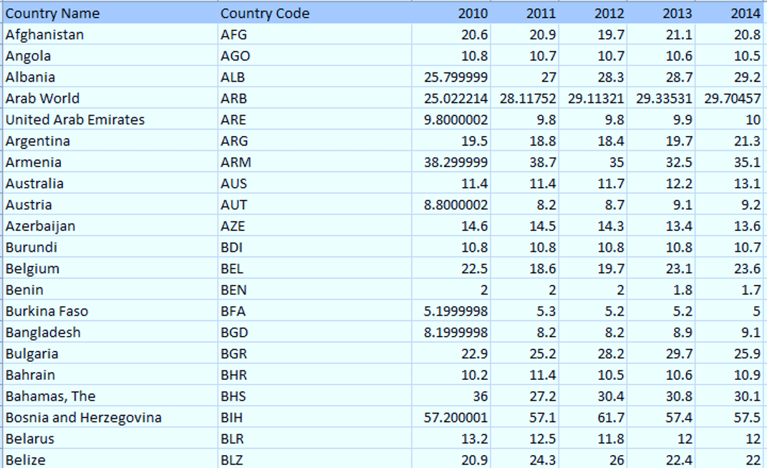
First, let us understand the dataset which contains the columns as Country Name, Country Code and the year from 2010 to 2014. Now using pandas, we will use “pd.read_csv” to read the .csv file format file.

Slide 46
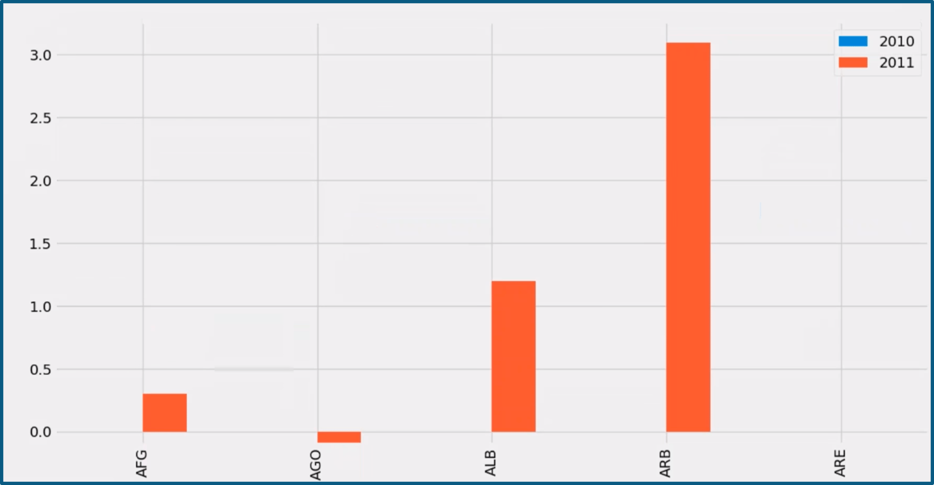
import pandas as pd
import matplotlib.pyplot as plt
from matplotlib import style
style.use('fivethirtyeight')
country= pd.read_csv("c:\users\home\appdata\Local\Programs\Python\Python37-32\Table105.csv",index_col=0)
country = country.iloc[:,1:] # all rows and columns from 2 to n
df= country.head(5)
df= df.set_index(["Country Code"])
sd = df.reindex(columns=['2010','2011'])
db= sd.diff(axis=1)
db.plot(kind="bar")
plt.show()

